Slide 1

BS – 101 Engineering Physics
Lecture – 13
Engr. Safee Ullah

Slide 2
The Atom
All matter is composed of atoms; all atoms consist of electrons, protons, and neutrons except normal hydrogen, which does not have a neutron. Each element in the periodic table has a unique atomic structure, and all atoms within a given element have the same number of protons. At first, the atom was thought to be a tiny indivisible sphere.

Slide 3
The Atom (Contd.)
At first, the atom was thought to be a tiny indivisible sphere. Later it was shown that the atom was not a single particle but was made up of a small dense nucleus around which electrons orbit at great distances from the nucleus, similar to the way planets orbit the sun. Niels Bohr proposed that the electrons in an atom circle the nucleus in different obits, similar to the way planets orbit the sun in our solar system.

Slide 4
The Atom (Contd.)
Niels Bohr proposed that the electrons in an atom circle the nucleus in different obits, similar to the way planets orbit the sun in our solar system. The Bohr model is often referred to as the planetary model. Another view of the atom called the quantum model is considered a more accurate representation, but it is difficult to visualize.
For most practical purposes in electronics, the Bohr model suffices and is commonly used because it is easy to visualize.

Slide 5
The Bohr Model
An atom is the smallest particle of an element that retains the characteristics of that element. Each of the known 118 elements has atoms that are different from the atoms of all other elements. This gives each element a unique atomic structure. According to the classical Bohr model, atoms have a planetary type of structure that consists of a central nucleus surrounded by orbiting electrons, as illustrated in Figure.

Slide 6
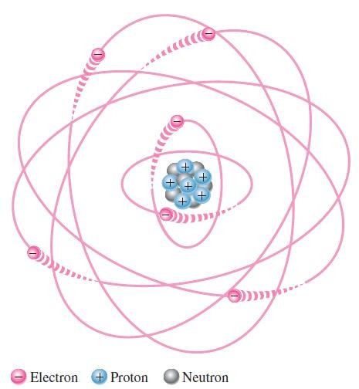
The Bohr Model

Slide 7
The Bohr Model (Contd.)
The nucleus consists of positively charged particles called protons and uncharged particles called neutrons. The basic particles of negative charge are called electrons. Each type of atom has a certain number of electrons and protons that distinguishes it from the atoms of all other elements.

Slide 8
The Bohr Model (Contd.)
For example, the simplest atom is that of hydrogen, which has one proton and one electron, as shown in Figure. As another example, the helium atom, shown in Figure, has two protons and two neutrons in the nucleus and two electrons orbiting the nucleus.

Slide 9
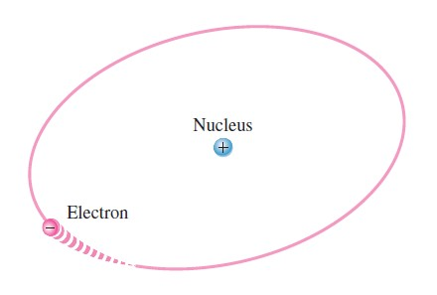
The Bohr Model (Hydrogen Atom)

Slide 10
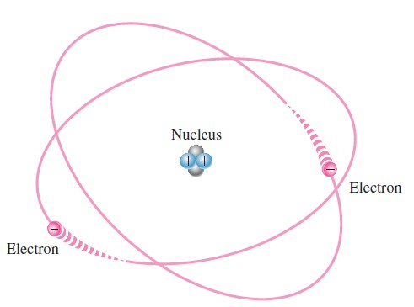
The Bohr Model (Helium Atom)

Slide 11
Atomic Number
The atomic number equals the number of protons in the nucleus, which is the same as the number of electrons in an electrically balanced (neutral) atom.
All elements are arranged in the periodic table of the elements in order according to their atomic number.
For example, hydrogen has an atomic number of 1 and helium has an atomic number of 2.
In their normal (or neutral) state, all atoms of a given
element have the same number of electrons as the positive charges cancel the negative
protons;
charges, and the atom has a net charge of zero.

Slide 12
Electrons and Shells
Energy Levels
Electrons orbit the nucleus of an atom at certain distances from the nucleus.
Electrons near the nucleus have less energy than those in more distant orbits. Only discrete (separate and distinct) values of electron energies exist within atomic structures.
Therefore, electrons must orbit only at discrete distances from the nucleus. Each discrete distance (orbit) from the nucleus corresponds to a certain energy level.

Slide 13
Electrons and Shells (Contd.)
In an atom, the orbits are grouped into energy levels known as shells.
A given atom has a fixed number of shells. Each shell has a fixed maximum number of electrons.
The shells (energy levels) are designated 1, 2, 3, and so on, with 1 being closest to the nucleus.
The Bohr model of the silicon atom is shown in Figure. Notice that there are 14 electrons and 14 each of protons and neutrons in the nucleus.

Slide 14
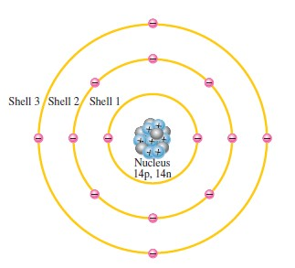
Illustration of the Bohr model of the silicon atom.

Slide 15
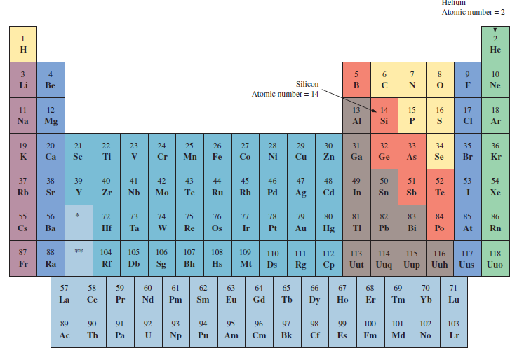
Periodic Table of Elements

Slide 16
Maximum Number of Electrons in Each Shell
The maximum number of electrons 𝑁_{𝑒} that can exist in each shell of an atom is a fact of nature and can be calculated by the formula,
𝑁_{𝑒} = 2𝑛²
Where 𝑛 is the number of the shell. The maximum number of electrons that can exist in the innermost shell (shell1) is
𝑁_{𝑒} = 2𝑛² = 2(1)²= 2

Slide 17
Maximum Number of Electrons in Each Shell (Contd.)
The maximum number of electrons that can exist in the shell 2 is
𝑁_{𝑒} = 2𝑛² = 2(2)²= 8
The maximum number of electrons that can exist in the shell 3 is
𝑁_{𝑒} = 2𝑛² = 2(3)²= 18
The maximum number of electrons that can exist in the shell 4 is
𝑁_{𝑒} = 2𝑛² = 2(4)²= 32

Slide 18
Valence Electrons
Electrons that are in orbits farther from the nucleus have higher energy and are less tightly bound to the atom than those closer to the nucleus.
This is because the force of attraction between the positively charged nucleus and the negatively charged electron decreases with increasing distance from the nucleus.
Electrons with the highest energy exist in the outermost shell of an atom and are relatively loosely bound to the atom.
This outermost shell is known as the valence shell and electrons in this shell are called valence electrons.

Slide 19
Valence Electrons (Contd.)
This outermost shell is known as the valence shell and electrons in this shell are called valence electrons.
These valence electrons contribute to chemical reactions and bonding within the structure of a material and determine its electrical properties.
When a valence electron gains sufficient energy from an external source, it can break free from its atom.
This is the basis for conduction in materials.

Slide 20
Ionization
When an atom absorbs energy from a heat source or from light, for example, the energies of the electrons are raised.
The valence electrons possess more energy and are more loosely bound to the atom than inner electrons, so they can easily jump to higher energy shells when external energy is absorbed by the atom.
If a valence electron acquires a sufficient amount of energy, called ionization energy, it can actually escape from the outer shell and the atom’s influence.

Slide 21
Ionization (Contd.)
The departure of a valence electron leaves a previously neutral atom with an excess of positive charge (more protons than electrons).
The process of losing a valence electron is known as ionization, and the resulting positively charged atom is called a positive ion.
For example, the chemical symbol for hydrogen is
H. When a neutral hydrogen atom loses its valence electron and becomes a positive ion, it is designated 𝐻⁺. The escaped valence electron is called a free electron.

Slide 22
Ionization (Contd.)
The reverse process can occur in certain atoms when a free electron collides with the atom and is captured, releasing energy.
The atom that has acquired the extra electron is called a negative ion. The ionization process is not restricted to single atoms.
In many chemical reactions, a group of atoms that are bonded together can lose or acquire one or more electrons.

Slide 23
Ionization (Contd.)
For some nonmetallic materials such as chlorine, a free electron can be captured by the neutral atom, forming a negative ion.
In the case of chlorine, the ion is more stable than the neutral atom because it has a filled outer shell. The chlorine ion is designated as
𝐶𝑙⁻

Slide 24
The Quantum Model
The quantum model is considered to be more accurate.
The quantum is a statistical model and very difficult to understand and visualize.
Like the Bohr model, the quantum model has a nucleus of protons and neutrons surrounded by electrons.
Unlike the Bohr model, the electrons in the quantum model do not exist in precise circular orbits as particles

Slide 25
The Quantum Model (Contd.)
Wave Particle Duality
Uncertainty Principle
In the quantum model, each shell or energy level consists of up to four subshells called orbitals, which are designated s, p, d and f.
Orbital s can hold a maximum of two electrons
, orbital p can hold six electrons, orbital d can hold ten electrons, and orbital f can hold fourteen electrons

Slide 26

Electron Configuration
Electron Configuration for Nitrogen

Slide 27
Electron Configuration (Example)
Describe the electron configuration of a silicon (Si) atom. (Hint: 14 Electrons)

Slide 28
Electron Configuration (Example)
Describe the electron configuration of a selenium (Sn) atom. (Hint: 50 electrons) even
Arsenic (33 electrons) odd

Slide 29
Materials Used in Electronics
Insulators
Conductors
Semiconductors

Slide 30
Insulators
An insulator is a
material current good
than
that does not
conduct electrical
under normal
conditions. Most
insulators are
compounds rather
single-element
materials and have very high resistivities.
Valence electrons | are tightly | bound to | the
atoms; therefore, | there are | very few | free
electrons in an | insulator. | Examples | of
insulators are rubber, plastics, glass, mica, and quartz.

Slide 31
Conductors
A conductor is a material that easily conducts electrical current. Most metals are good conductors. The best conductors are single- element materials, such as copper (Cu), silver (Ag), gold (Au), and aluminum (Al), which are characterized by atoms with only one valence electron very loosely bound to the atom. These loosely bound valence electrons become free electrons. Therefore, in a conductive material the free electrons are valence electrons.

Slide 32
Semiconductors
A semiconductor is a material that is between conductors and insulators in its ability to conduct electrical current. A semiconductor in its pure (intrinsic) state is neither a good conductor nor a good insulator. Single-element semiconductors are antimony (Sb), arsenic (As), astatine (At), boron (B), polonium (Po), tellurium (Te), silicon (Si), and germanium (Ge). Compound semiconductors such as gallium arsenide, indium phosphide, gallium nitride, silicon carbide, and silicon germanium are also commonly used. The single- element semiconductors are characterized by atoms with four valence electrons. Silicon is the most commonly used semiconductor.

Slide 33
Band Gap
Recall that the valence shell of an atom represents a band of energy levels and that the valence electrons are confined to that band.
When an electron acquires enough additional energy, it can leave the valence shell, become a free electron, and exist in what is known as the conduction band.
The difference in energy between the valence band and the conduction band is called an energy gap or band gap.

Slide 34
Band Gap (Contd.)
The difference in energy between the valence band and the conduction band is called an energy gap or band gap.
This is the amount of energy that a valence electron must have in order to jump from the valence band to the conduction band.
Once in the conduction band, the electron is free to move throughout the material and is not tied to any given atom.

Slide 35
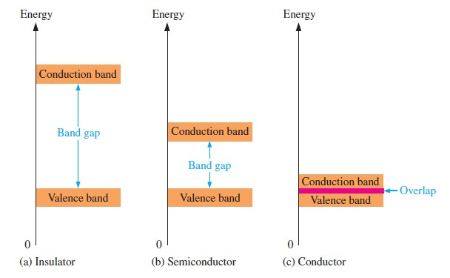
Band Gap (Contd.)

